Slide 1
What the Bible Says About the Law of God
Notes:
I confess to you today, that I haven’t always loved the laws of God. And there are times today, even after I’ve been baptized and a Christian for a long time, that I still don’t. Like when the Holy Spirit impresses me to admit I’m wrong. Or say I’m sorry. Or change my mind. In high school, I didn’t like other stuff. Like…

Slide 2
Separate Sidewalks
Notes:
Seriously, at my Christian boarding school, guys and girls had separate sidewalks. Somehow, that didn’t prevent some kids from getting on social or experimenting with sex or substances. But we had a rule about not walking together on certain sidewalks. I really didn’t like that rule.

Slide 3
Lights Out
Notes:
I’ll never forget the first night I stayed in the guy’s dorm and at 10pm, not just the lights but literally all the power went out. You couldn’t see your hand in front of your face. When they said it was time for lights out, they weren’t messing around at my school. I didn’t like that rule either.

Slide 4
It’s all good (Isaiah 8:20; Luke 24:44; Psalm 1:1-2; Deuteronomy 4:8; Romans 13:8-10; Romans 7:7; Psalm 40:8; Jeremiah 31:33; Psalm 19:7-10)
Used correctly (1 Timothy 1:8; Romans 3:20; James 1:22-25; Matthew 5:17-20; Galatians 3:24; Romans 3:31; Romans 7:12,14; Romans 10:4)
Throughout eternity (Genesis 21:33; Psalm 111:7-8; Genesis 26:5; Genesis 39:9; Psalm 119:105; Revelation 11:19; John 14:15; 1 John 5:3)
Notes:
But what you learn when you read God’s word, is that the people in it love God’s laws. All of them. Apparently even the one about putting you to death if you curse your parents (Leviticus 20:9). Though I don’t recall any story or verse saying that actually took place. That’s why Isaiah basically says, “everything is awesome” about the Old Testament. Isaiah 8:20 says…

Slide 5
Isaiah 8:20
20 Look to God's instructions and teachings! People who contradict his word are completely in the dark.
Notes:
Maybe you memorized the NKJ version like I did.

Slide 6
Isaiah 8:20 (NKJV)
20 To the law and to the testimony! If they do not speak according to this word, it is because there is no light in them.
Notes:
Everybody back then knew that the first five books of Moses are Torah or law. So when Isaiah said to the law and testimony, he was really referring to the entire Old Testament. Jesus said the same thing in Luke 24:44…

Slide 7
Luke 24:44
44 Then he said, 'When I was with you before, I told you that everything written about me in the law of Moses and the prophets and in the Psalms must be fulfilled.
Notes:
Here Jesus adds the Psalms, which He quoted more than any other Old Testament book, especially on the cross, as the third category of Old Testament writings. What He meant was “everything is awesome.” It’s all good in God’s hood. When you understand law this way, you can’t stop thinking about it. Psalm 1:1-2 says…

Slide 8
Psalm 1:1-2
1 Oh, the joys of those who do not follow the advice of the wicked, or stand around with sinners, or join in with mockers. 2 But they delight in the law of the LORD, meditating on it day and night.
Notes:
The last time I went to Israel, one guy I saw on the plane was rocking back and forth delighting in the law of the Lord right in the middle of the aisle in the middle of trans-Atlantic flight. He had pieces of the law attached to his head and arms and a prayer shawl around his shoulders. He was literally meditating on it day and night! And since none of us could sleep anyway, we were meditating with him.

Slide 9
Psalm 1:1-2
1 Oh, the joys of those who do not follow the advice of the wicked, or stand around with sinners, or join in with mockers. 2 But they delight in the law of the LORD, meditating on it day and night.
Notes:
When we arrived in Israel, I’ll never forget the boisterous joyful way the dining room exploded when the sun went down. This was no quiet “day is dying in the west” kind of song they sang. No, this was a “happy birthday to you and you and you and you” kind of song where everyone in the dining room was watching them and they didn’t care! Because Sabbath was finally there. And Sabbath is awesome and good. More about that next week. Listen to how they brag about their laws in Deuteronomy 4:8.

Slide 10
Deuteronomy 4:8
8 And what great nation has decrees and regulations as righteous and fair as this body of instructions that I am giving you today?
Notes:
When I saw the way the awesome Jews welcome the Sabbath, I have to say I agree with Moses and the people in this verse. It is all good in God’s hood! Now, I still don’t get that death penalty for parental disrepect…but hey, God meets us where we are and that’s where they were. Dobson wouldn’t approve but I digress…So law can be the entire Old Testament or they can be a specific reference to the 10 commandments as Romans 13 makes clear.

Slide 11
Romans 13:8-10
8 Owe nothing to anyone—except for your obligation to love one another. If you love your neighbor, you will fulfill the requirements of God's law. 9 For the commandments say, 'You must not commit adultery. You must not murder. You must not steal. You must not covet.'
Notes:
God’s people in Bible days, Old and New Testaments, didn’t think negatively about law. Ceremonial or moral or gravity or whatever. They loved it all. Because they knew they came from a loving God. Exodus 34:1-7 says after Moses so rudely wrecked the first copy of God’s moral law, “1 Then the LORD told Moses, "Chisel out two stone tablets like the first ones. I will write on them the same words that were on the tablets you smashed. 2 Be ready in the morning to

Slide 12
Romans 13:8-10
8 Owe nothing to anyone—except for your obligation to love one another. If you love your neighbor, you will fulfill the requirements of God's law. 9 For the commandments say, 'You must not commit adultery. You must not murder. You must not steal. You must not covet.'
Notes:
climb up Mount Sinai and present yourself to me on the top of the mountain. 3 No one else may come with you. In fact, no one is to appear anywhere on the mountain. Do not even let the flocks or herds graze near the mountain.” 4 So Moses chiseled out two tablets of stone like the first ones. Early in the morning he climbed Mount Sinai as the LORD had commanded him, and he carried the two stone tablets in his hands. 5 Then the LORD came down in a cloud and

Slide 13
Romans 13:8-10
8 Owe nothing to anyone—except for your obligation to love one another. If you love your neighbor, you will fulfill the requirements of God's law. 9 For the commandments say, 'You must not commit adultery. You must not murder. You must not steal. You must not covet.'
Notes:
stood there with him; and he called out his own name, Yahweh. 6 The LORD passed in front of Moses, calling out, "Yahweh! The LORD! The God of compassion and mercy! I am slow to anger and filled with unfailing love and faithfulness. 7 I lavish unfailing love to a thousand generations. I forgive iniquity, rebellion, and sin. But I do not excuse the guilty.”

Slide 14
Romans 13:8-10
8 Owe nothing to anyone—except for your obligation to love one another. If you love your neighbor, you will fulfill the requirements of God's law. 9 For the commandments say, 'You must not commit adultery. You must not murder. You must not steal. You must not covet.'
Notes:
So they loved all the laws. And they especially loved the moral laws in the 10 commandments. Because it’s in the context of the re-gifting of the 10 commandments that God describes Himself as gracious and loving for the first time. Though that was repeated in Numbers 14:18; Nehemiah 9:17; Psalm 86:15; Psalm 103:8; Psalm 145:8; Jeremiah 32:18; Joel 2:13; Jonah 4:2; and Nahum 1:3. You think loving law is important to God?

Slide 15
Romans 13:8-10
8 Owe nothing to anyone—except for your obligation to love one another. If you love your neighbor, you will fulfill the requirements of God's law. 9 For the commandments say, 'You must not commit adultery. You must not murder. You must not steal. You must not covet.'
Notes:
So the Bible refers to law as the Old Testament, as a bunch of laws especially for Israel, and then sometimes also refers to laws written in stone by God’s own finger meant to convey everlasting significance for everyone all time. Only context helps us determine which kind of laws any specific verse elsewhere is referring to. This next one is clearly a reference to the 10 commandments as law. Romans 7:7 says,

Slide 16
Romans 7:7
7 Well then, am I suggesting that the law of God is sinful? Of course not! In fact, it was the law that showed me my sin. I would never have known that coveting is wrong if the law had not said, 'You must not covet.'
Notes:
Which is of course a reference to Exodus 20:17 and the 10th commandment. We will come back to the purpose of the law in identifying sin, leading us to Jesus, and how live for Jesus later. But for now, please notice the joy the instructions and commandments of God give people. Psalm 40:8 says…

Slide 17
Psalm 40:8
8 I take joy in doing your will, my God, for your instructions are written on my heart.
Notes:
What’s the psalmist saying? It’s all good in God’s hood! God is love and so is His law. You know you understand this correctly when you’re willing to obey God’s laws from your heart. Not because your parents make you. Or because you were raised this way. Or because if you don’t, you’re afraid of going to hell. No, perfect love casts out fear according to 1 John 4:18. And then tatoos it on the inside of your heart.

Slide 18
Jeremiah 31:33
33 'But this is the new covenant I will make with the people of Israel on that day,' says the LORD. 'I will put my instructions deep within them, and I will write them on their hearts. I will be their God, and they will be my people.'
Notes:
Who does Jeremiah say engrave God’s commandments and laws on our hearts so we want to obey them? God! They were never supposed to be bracelets and bumper stickers. They’re supposed to be transplants! And when you finally figure out that God is gonna perform the operation, that’s when Klove takes over and you just wanna sing about them all time. This morning, we’re going to do that old school with a tune from the rainbow book as I call it. It’s based on Psalm 19:7-10 and has something to do with honeycomb. The song not the cereal. Sing with me will you?

Slide 19
Psalm 19:7-10
7 The instructions of the LORD are perfect, reviving the soul. The decrees of the LORD are trustworthy, making wise the simple. 8 The commandments of the LORD are right, bringing joy to the heart. The commands of the LORD are clear, giving insight for living.

Slide 20
Psalm 19:7-10
9 Reverence for the LORD is pure, lasting forever. The laws of the LORD are true; each one is fair. 10 They are more desirable than gold, even the finest gold. They are sweeter than honey, even honey dripping from the comb.

Slide 21
The Law of the Lord Psalm 19
The law of the Lord is perfect
Refreshing my soul
The word of the Lord is sure
Revealing His wisdom
More to be desired are they than gold
Yea, than much fine gold
Sweeter also than honey
And the honeycomb

Slide 22
The Law of the Lord Psalm 19
The standards of the Lord are right
Bestowing great joy
The command of the Lord is pure
Directing my way
More to be desired are they than gold
Yea, than much fine gold
Sweeter also than honey
And the honeycomb

Slide 23
The Law of the Lord Psalm 19
May the words that I speak aloud
And my mind’s secret whisperings
Be according to your will, O Lord
My Rock and my Redeemer
More to be desired are they than gold
Yea, than much fine gold
Sweeter also than honey
And the honeycomb

Slide 24
It’s all good (Isaiah 8:20; Luke 24:44; Psalm 1:1-2; Deuteronomy 4:8; Romans 13:8-10; Romans 7:7; Psalm 40:8; Jeremiah 31:33; Psalm 19:7-10)
Used correctly (1 Timothy 1:8; Romans 3:20; James 1:22-25; Matthew 5:17-20; Galatians 3:24; Romans 3:31; Romans 7:12,14; Romans 10:4)
Throughout eternity (Genesis 21:33; Psalm 111:7-8; Genesis 26:5; Genesis 39:9; Psalm 119:105; Revelation 11:19; John 14:15; 1 John 5:3)
Notes:
So point number one, God’s laws are all good. But they are especially tasty when used correctly. Which is point number two. Listen to how Paul explains this to Timothy in 1 Timothy 1:8.

Slide 25
1 Timothy 1:8
8 We know that the law is good when used correctly.
Notes:
So there’s a right way and a wrong way to use the law. The right way is to see law as love from a God that is love. And embrace it. What’s the wrong way to use it? Romans 3:20 tells us…

Slide 26
Romans 3:20
20 For no one can ever be made right with God by doing what the law commands. The law simply shows us how sinful we are.
Notes:
The laws are good. Because they help us identify sin. And direct us to Jesus. Who saves us from our sin. And shows us how to live by following His advice. These are the purposes of the law. But when we try to follow these laws to appease our parents or make ourselves look good or impress God, we epic fail. Because no one can ever be made right with God by the law. Adventists need to remember this when they read Revelation 13 and 14. And those who disagree with Adventists need to remember we said this when they read Revelation 13 and 14.

Slide 27
Romans 3:20
20 For no one can ever be made right with God by doing what the law commands. The law simply shows us how sinful we are.
Notes:
Which we’ll talk about in a few weeks so don’t go anywhere. We are never saved by keeping the Sabbath or the law. Now or in the future. But the Sabbath is important to God. And will become more significant. Some people hate it when Scripture does this, when God says this is true, and this is also true. But that’s the way it is. Unless you wish to rip some stuff out. Moving on, James has some good advice about using the law correctly.

Slide 28
James 1:22-25
22 But don't just listen to God's word. You must do what it says. Otherwise, you are only fooling yourselves. 23 For if you listen to the word and don't obey, it is like glancing at your face in a mirror.

Slide 29
James 1:22-25
24 You see yourself, walk away, and forget what you look like. 25 But if you look carefully into the perfect law that sets you free, and if you do what it says and don't forget what you heard, then God will bless you for doing it.
Notes:
I hope we will be a church that is full of good hearers and doers of God’s laws. We’ll never obey perfectly since none of us is Jesus. But we can sincerely imitate Him and like He told His disciples in Matthew 28, go and make disciples of all nations, baptizing them in the name of the Father and the Son and the Holy Spirit and teaching these new disciples to obey all the commands I have given you.

Slide 30
James 1:22-25
24 You see yourself, walk away, and forget what you look like. 25 But if you look carefully into the perfect law that sets you free, and if you do what it says and don't forget what you heard, then God will bless you for doing it.
Notes:
God’s laws and commandments are obviously important to Jesus and Jesus’ brother James. Long after He died on the cross. Are they important to you? Are you sincerely obeying them out of love? I think Jesus knew God’s commandments and laws would be mistakenly abolished and nailed to the cross. So He tried to warn us about that in Matthew 5.

Slide 31
Matthew 5:17-20
17 "Don't misunderstand why I have come. I did not come to abolish the law of Moses or the writings of the prophets. No, I came to accomplish their purpose. 18 I tell you the truth, until heaven and earth disappear, not even the smallest detail of God's law will disappear until its purpose is achieved.
Notes:
Here, to be fair, I think from context Jesus is referring to all the Old Testament since he refers to the Law of Moses (Torah) AND the writings of the prophets. He’s saying the entire Old Testament pointed forward to His arrival. But included in the Old Testament were the 10 commandments right? We already read in Exodus 34 how God had to make Moses a second set. Like Ellen White in 1888, I don’t believe its fair to say that this verse or another in Galatians was only referring to ceremonial laws

Slide 32
Matthew 5:17-20
17 "Don't misunderstand why I have come. I did not come to abolish the law of Moses or the writings of the prophets. No, I came to accomplish their purpose. 18 I tell you the truth, until heaven and earth disappear, not even the smallest detail of God's law will disappear until its purpose is achieved.
Notes:
because verse 18 says even the smallest most insignificant detail, such as not talking back to your parents, pointed people to the 5th commandment about honoring your Father and Mother. Galatians 3:24 says it this way…

Slide 33
Galatians 3:24
24 Let me put it another way. The law was our guardian until Christ came; it protected us until we could be made right with God through faith. 25 And now that the way of faith has come, we no longer need the law as our guardian.
Notes:
The purpose of the laws of God, ceremonial and moral, were designed by a loving God to identify sin, direct us to Jesus, and help us live for Him. That’s what a tutor or guardian in Bible days did. Carl P. Cosaert, who holds his doctoral degree in New Testament and Early Christianity and is a professor of biblical studies at Walla Walla University, says in his book I recommend entitled “Galatians: A Fiery Response to a Struggling Church”, that…

Slide 34
Notes:
“God’s law did not cease to exist with the arrival of Christ. Sure certain aspects of it were fulfilled , but its moral truths continue to be true today as much as they were 4,000 years ago. Unfortunately, many have interpreted Paul’s comment as a complete dismissal of the law. But that makes little sense, however, in light of his positive comments about the law else where” (78-79). Such as…

Slide 35
Romans 3:31
31 Well then, if we emphasize faith, does this mean that we can forget about the law? Of course not! In fact, only when we have faith do we truly fulfill the law.

Slide 36
Romans 7:12,14
12 But still, the law itself is holy, and its commands are holy and right and good. 14 So the trouble is not with the law, for it is spiritual and good. The trouble is with me, for I am all too human, a slave to sin.

Slide 37
Notes:
Cosaert continues, “in the life, death, and resurrection of Jesus, the promised Messiah, the law has been overshadowed…Although Christ has come, many of us often live our lives as if He had not. We find ourselves continuing to struggle under sin. In those periods of our lives God’s law acts as a tutor or guardian hunting us down, declaring our sin, giving us a guilty conscience, and in the process always seeking to drive us to Christ as our only hope…

Slide 38
Notes:
The defining moment in the scope of salvation history for us as Christians is not the presentation of the law on Mount Sinai…It is the one event that has forever changed the course of human history—the incarnation of Christ” (80). But in the history of our church, we’ve had our challenges even after 1888 when righteousness by faith was emphasized balancing the Gospel with the Law. As this first picture conveys.

Slide 39
Which picture will we take?
Notes:
Commissioned in 1876 by James White, this picture was entitled "The Way of Life, From Paradise Lost To Paradise Restored.” It is a picture of the plan of salvation and mission of the church from Eden to Eden. You see Adam and Eve exiting the Garden of Eden. There is Cain and Able, the sacrificial service. Over on the right of the picture is the baptism of Jesus, the Lord’s Supper, and the New Jerusalem.

Slide 40
Which picture will we take?
Notes:
But in the middle is a huge tree with ten branches, one for each of the Ten Commandments. Jesus is on the cross. But it is the law that is the dominant motif in this picture.

Slide 41
Which picture will we take?
Notes:
But James White died in 1881. And after he did, his wife [and co-founder of our church] Ellen White commissioned a new picture to illustrate the plan of salvation and mission of the Adventist Church. This new picture was completed in 1883 and was entitled "Christ—The Way of Life." The same elements are there but note the big change: The law still there but has been moved to the foothills of Mt. Sinai behind the cross.

Slide 42
Which picture will we take?
Notes:
This is the picture that she wanted to emphasize and us to be known by. But what about Romans 10:4? If the law is still good in God’s hood, what did Paul mean when he said it ended?

Slide 43
Romans 10:4
1 Dear brothers and sisters, the longing of my heart and my prayer to God is for the people of Israel to be saved. 2 I know what enthusiasm they have for God, but it is misdirected zeal. 3 For they don't understand God's way of making people right with himself.

Slide 44
Romans 10:4
Refusing to accept God's way, they cling to their own way of getting right with God by trying to keep the law. 4 For Christ has already accomplished the purpose for which the law was given. As a result, all who believe in him are made right with God.
Notes:
The NKJV says it this way…

Slide 45
Romans 10:4 (NKJV)
4 For Christ is the end of the law for righteousness to every one that believeth.
Notes:
Is he saying that the loving law God gave to Moses at Sinai, and God’s expectations of obedience, were terminated by Christ? No, because Paul’s use of the word ‘law’ refers to the Torah or entire Old Testament Scripture and the term ‘end’ can mean ‘purpose’, ‘goal’, or ‘ultimate meaning’ not ‘end’ or ‘termination.” This is the position held by most interpreters from the early church through the Protestant Reformation. Jesus fills everything full and personifies the law.

Slide 46
Romans 10:4 (NKJV)
4 For Christ is the end of the law for righteousness to every one that believeth.
Notes:
The entire Old Testament including the law pointed people to Jesus the lawgiver (James 4:12). And Jesus overshadows everything including the law. Which is simply the way it should be. But that same Jesus wouldn’t have told His disciples to teach everyone to obey it (Matthew 28:19-20) if He was trying to end it. So let’s use the law correctly.

Slide 47
It’s all good (Isaiah 8:20; Luke 24:44; Psalm 1:1-2; Deuteronomy 4:8; Romans 13:8-10; Romans 7:7; Psalm 40:8; Jeremiah 31:33; Psalm 19:7-10)
Used correctly (1 Timothy 1:8; Romans 3:20; James 1:22-25; Matthew 5:17-20; Galatians 3:24; Romans 3:31; Romans 7:12,14; Romans 10:4)
Throughout eternity (Genesis 21:33; Psalm 111:7-8; Genesis 26:5; Genesis 39:9; Psalm 119:105; Revelation 11:19; John 14:15; 1 John 5:3)
Notes:
So what should we do about it? Praise God for it! All of it. Because it’s all good. If that is not your perceptions of God’s laws and commandments, then you need to unlearn your understanding of them and humble yourself because this isn’t about stupid stuff like sidewalks and lights out, this is about important things God carved with his own finger. Twice! You really think He wanted us to forget them? Or use them incorrectly? I don’t think so.

Slide 48
It’s all good (Isaiah 8:20; Luke 24:44; Psalm 1:1-2; Deuteronomy 4:8; Romans 13:8-10; Romans 7:7; Psalm 40:8; Jeremiah 31:33; Psalm 19:7-10)
Used correctly (1 Timothy 1:8; Romans 3:20; James 1:22-25; Matthew 5:17-20; Galatians 3:24; Romans 3:31; Romans 7:12,14; Romans 10:4)
Throughout eternity (Genesis 21:33; Psalm 111:7-8; Genesis 26:5; Genesis 39:9; Psalm 119:105; Revelation 11:18-19; John 14:15; 1 John 5:3)
Notes:
I think we’re probably gonna be partying with all God’s awesome people that love Jesus throughout eternity. Why? Because the laws of God are an eternal transcript of the character of God. Check this out.

Slide 49
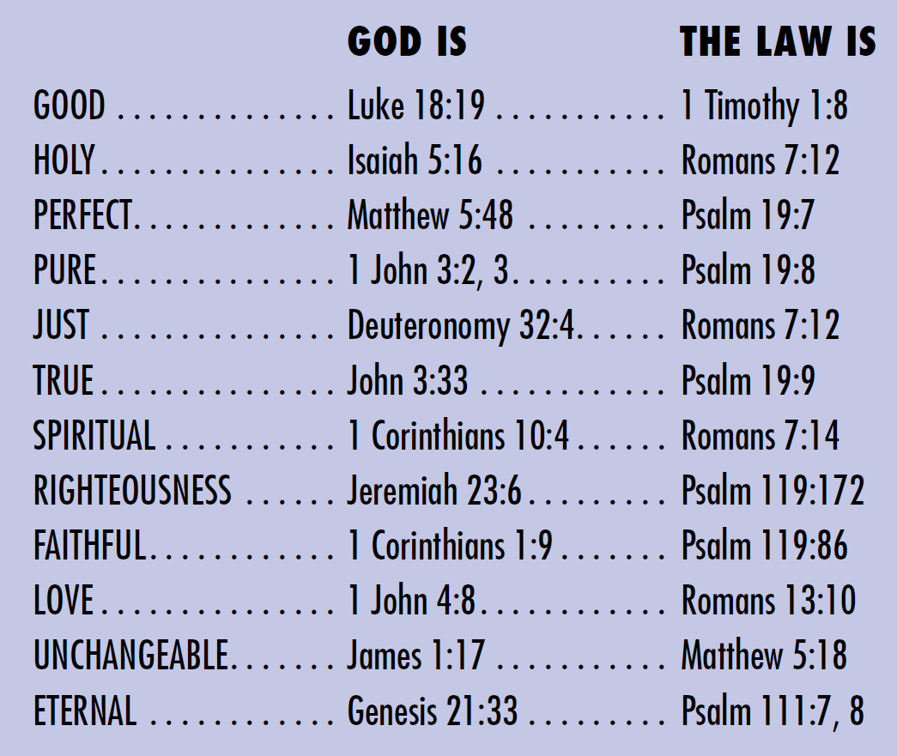
CHARACTER OF GOD
Notes:
The same characteristics that describe God describe His law. Isn’t God good? So is His law. Isn’t God Holy? So is law. In the future, won’t God still be perfect? So will His law. And it goes on and on and on with pure, just, true, spiritual, righteous, faithful, loving, unchangeable, and yes, eternal. Genesis 21:33 says…

Slide 50
Genesis 21:33
33 Then Abraham planted a tamarisk tree at Beersheba, and there he worshiped the LORD, the Eternal God.
Notes:
And Psalm 111:7-8 confirms…

Slide 51
Psalm 111:7-8
7 All he does is just and good, and all his commandments are trustworthy. 8 They are forever true.
Notes:
Abraham knew this long before God wrote them down the first time!

Slide 52
Genesis 26:5
5 Abraham listened to me and obeyed all my requirements, commands, decrees, and instructions.
Notes:
And so did Joseph when Potiphar’s wife tempted him with adultery in Genesis 39:9 even though God hadn’t carved the 7th commandment in stone yet.

Slide 53
Genesis 39:9
How could I do such a wicked thing? It would be a great sin against God.
Notes:
The Psalmist said…

Slide 54
PSALM 119:105
105 Your word is a lamp to my feet and a light to my path.
Notes:
Your word is lamp to my feet and a light to my path. Our Adventist pioneers stumbled upon this next verse in Revelation 11 and it encouraged them greatly to see that in the sanctuary in heaven at the end of the end of time the ark of His covenant was there. Because previously God had said in Exodus 25:16, “When the Ark is finished, place inside it the stone tablets inscribed with the terms of the covenant, which I will give to you.”

Slide 55
Revelation 11:19
19 Then, in heaven, the Temple of God was opened and the Ark of his covenant could be seen inside the Temple...
Notes:
With these two verses in Exodus 25 and Revelation 11, our founders saw eternal significance to the loving laws of God. Jesus said it this way in John 14:15…

Slide 56
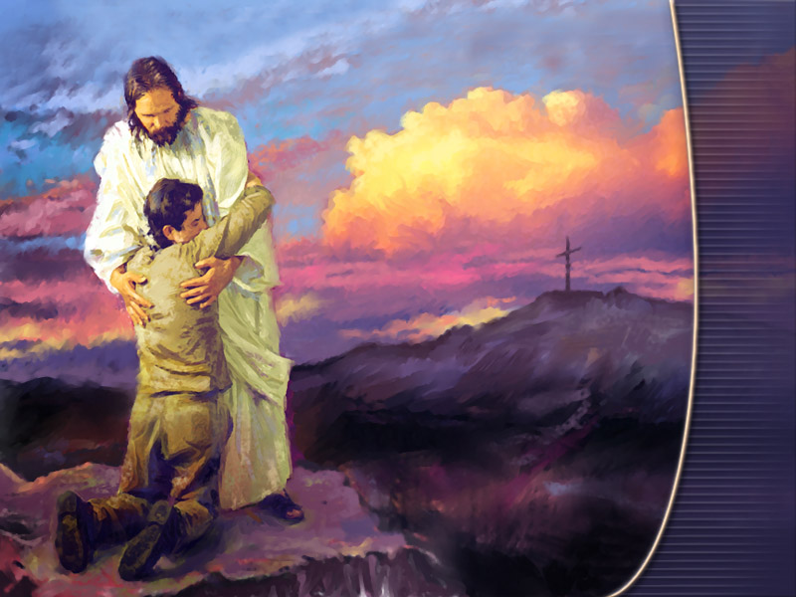
15 If you love me, obey my commandments.
-John 14:15
Notes:
And John added these important words in 1 John 5:3…

Slide 57
3 Loving God means keeping his commandments, and his commandments are not burdensome. - 1 John 5:3
Notes:
Skip MacCarty in his book In Granite or Ingrained? tells the story of a young girl named Melissa who was married to a mean, abusive husband named Edgar who wrote out a long ‘to do’ list for her every day before he went to work. If she hadn’t finished everything to his satisfaction by the time he returned, he would beat her. She lived in fear and misery and needless to say when Edgar died she hardly missed him.

Slide 58
3 Loving God means keeping his commandments, and his commandments are not burdensome. - 1 John 5:3
Notes:
A few years later, she fell deeply in love with a man named Allen. His loving concern for her made her life totally different. Rather than ordering her to do things, he discussed with her what things needed to be done and they divided their duties around the house.

Slide 59
Notes:
A few years later Melissa came upon one of Edgar’s old lists up in the attic. She felt the rush of adrenaline and a crawling sensation on her skin as she began to read the list. But then, suddenly she realized that everything on that list was something she was still doing regularly. But now, she loved doing it because she loved the man she was doing it for. The law hasn’t changed. But love can transform begrudging subservience into joyful cooperation (pp. 110-111).

Slide 60
Notes:
Skip MacCarty concludes, “It is not the number of commandments involved, nor the nature of the commandments, nor whether they were issued in the Old Testament or the New, that determines whether they engender slavery or freedom…but the heart that has been renewed by the Holy Spirit finds those same laws to be a yoke that is easy—Christ’s own yoke, which He offers to us by grace through faith.” (164)

Slide 61
Notes:
“The yoke of Christ is easy because He died for our sins and grants / imputes to us the righteousness of His sinless life—the very righteousness we need as our ‘passport’ to eternal life—as a gift which we can receive by faith. It is also easy because it represents His laws that are an expression of His love for us and which He has promised to write in our hearts” (164). Is that the way you look at God’s loving laws?

Slide 62
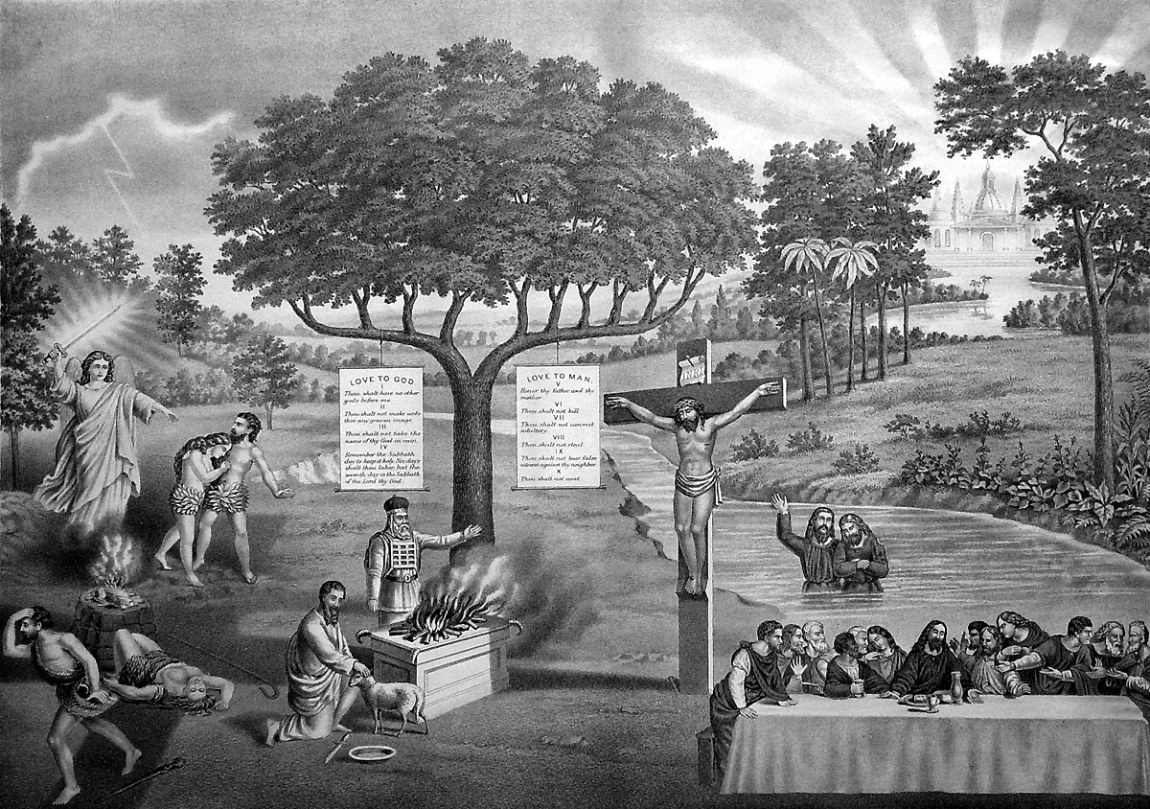
Which picture will we take?
Notes:
Which picture will we take? I hope it’s the one on the right. Even when we do, I think there will probably always be people who misunderstand the teachings of our church simply because we continue to say both are still important. And since I’m not willing to throw these other loving law Scriptures out, I’m becoming okay with that. But hey, maybe they will too throughout eternity.

Slide 63
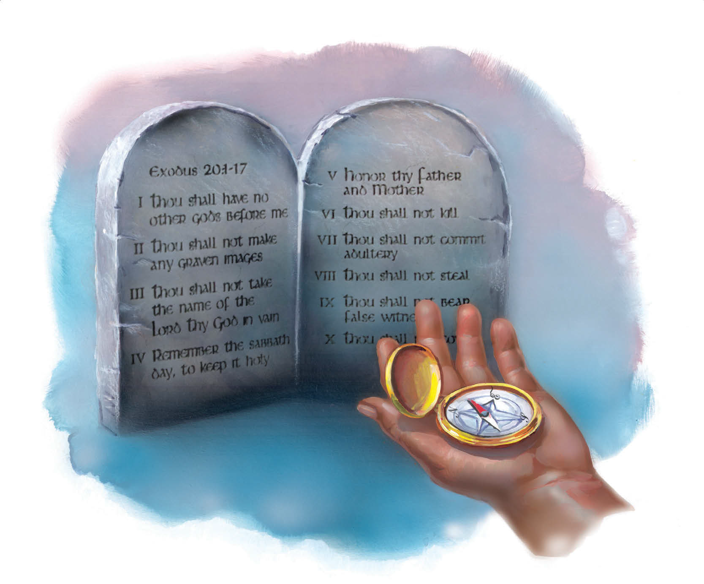
What the Bible Says About the Sabbath
Notes:
Next week, I’ll be doing Jackie’s grandfather’s funeral in Michigan. But Cavin and I have already been working on the message entitled What the Bible Says About the Sabbath. So I hope you will pray for him and listen to the message we have prepared for him to share from God’s word.

